Slide 1
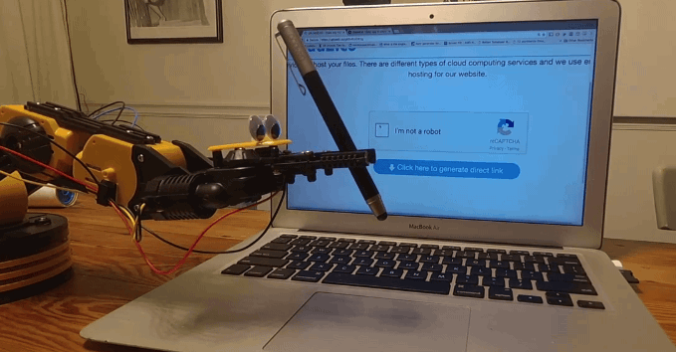
A web scrape to learn about women who make movies: 1979 - 2018

Slide 2
Rationale:
In the past 20 years, 3 women have won an academy award for best director.
Research Questions:

Slide 3
Research Questions:
Who makes movies?
How has the gender breakdown changed over the past 40 years?
Research Questions:

Slide 4
Tools:
IMDB
Scrapy
Python
gender-guesser
Jupyter Notebook
Numpy, Pandas, Seaborn
Research Questions:

Slide 5
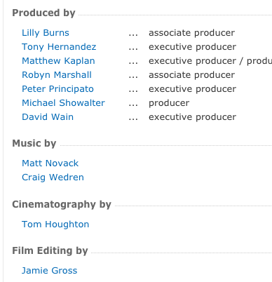
Investigation:
Imdb naming conventions and general site structure
Table architecture
Research Questions:

Slide 6
Spider(s):
Generated lists for the spider to search for the popular movies over multiple decades
Retrieved unique title number identifiers
Used title numbers to retrieve "Full Cast & Crew" pages and "Release Year" pages
Research Questions:

Slide 7
Data Quality/Uncertainty:
Info gathered on
Directors and Second Director Team
Production Team
Camera and Electric Team
Gender guesser uncertainty balance:
Each unknown was counted as .5 female
Research Questions:

Slide 8
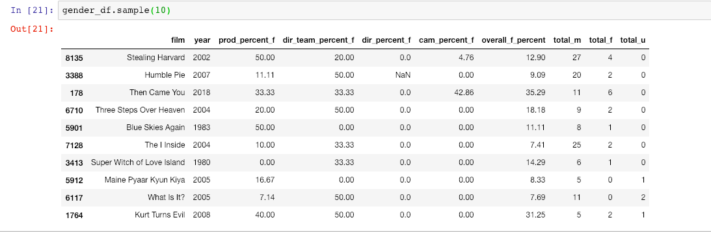
Data Quality/Uncertainty:
Research Questions:

Slide 9
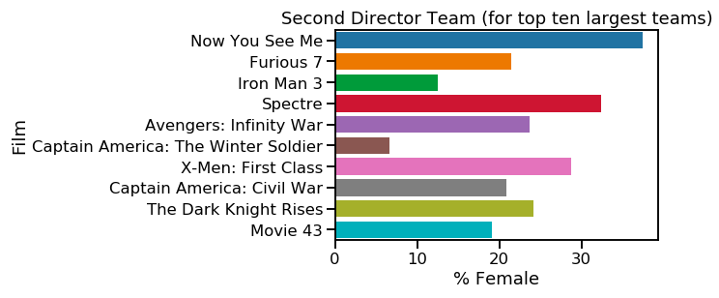
Results:
Research Questions:

Slide 10
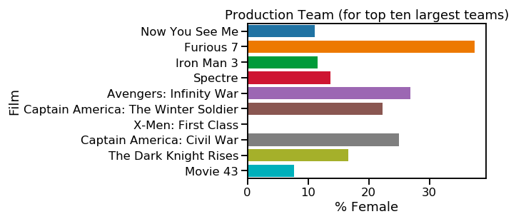
Results:
Research Questions:

Slide 11
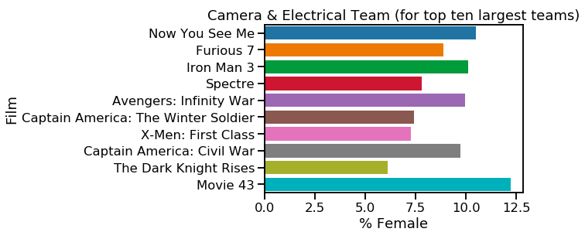
Results:
Research Questions:

Slide 12
Results:
Research Questions:

Slide 13
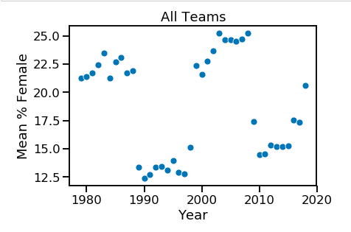
Results: % female across all teams

Slide 14
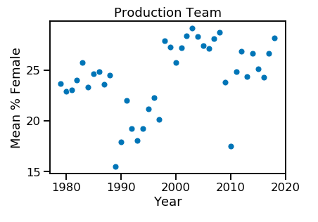
Results:

Slide 15
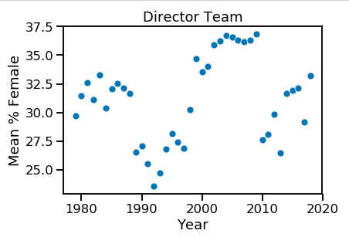
Results:

Slide 16
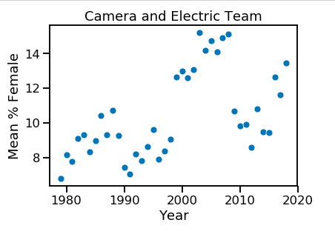
Results:

Slide 17
Future Work:
Use a better estimate for unknown and androgynous names
Split by genres
Incorporate more departments
How has the increase of women in this field affected recognition and awards?

Slide 18
Thanks!
Questions?

